Slide 1
Monte Carlo simulation of coarse-grained model for Halloysite Nanotube
Hye-jeong Cheon
Department of Physics, NTNU, Trondheim
14. Sep. 2018

Slide 2
Monte Carlo simulation of coarse-grained model Understanding molecules behaviour

Slide 3
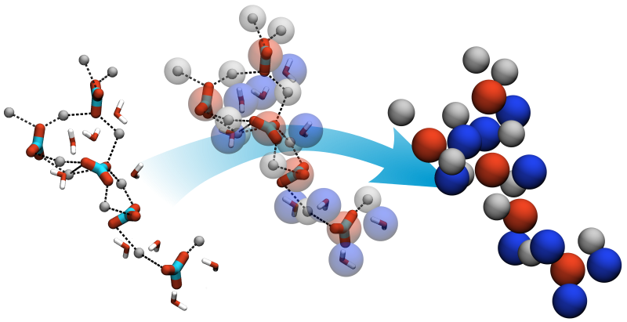
Monte Carlo simulation of coarse-grained model
Atomistic model
Coarse-grained model
Notes:
https://www.slideshare.net/Arabianpetroleum/ceplerley-lecture

Slide 4
Halloysite
Al₂Si₂O₅(OH)₄

Slide 5
Halloysite Nanotube Halloysite Nanotube structure and modelling system

Slide 6
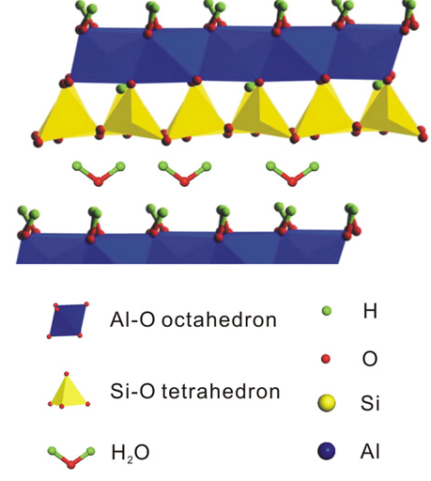
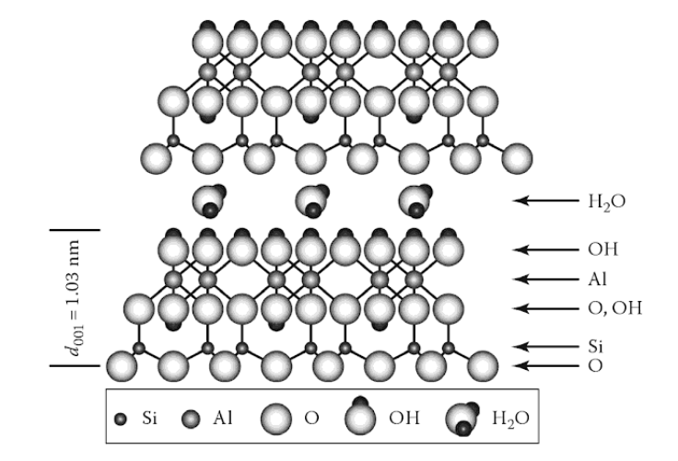
Halloysite structure and property
Al₂Si₂O₅(OH)₄•2H₂O
Sheet becomes tube
: Inside(Al) and Outside (Si)
Soil and Water Chemistry: An Integrative Approach, Second Edition, Av Michael E. Essington, p86
https://www.eng.ed.ac.uk/about/news/20160105/flagship-research-programme-awarded-epsrc-grant, sep 2018
Notes:
Soil and Water Chemistry: An Integrative Approach, Second Edition, Av Michael E. Essington, p86
the stress on the plane of the apical oxygen, lying in the middle of the unit layer, is hardly affected by the interlayer water molecules. To compensate this stress, Hal adopts both a rotation of the tetrahedron and a rolling of the unit layer (Fig. 2) to correct the mismatch between the plane of the apical oxygen and the plane of the inner hydroxyl and merges them into a single plane. In the rotation mechanism,

Slide 7
Halloysite structure and property
Different charge with different pH
: Inside(Al,+) and Outside (Si,-)
Al₂Si₂O₅(OH)₄•2H₂O
https://www.eng.ed.ac.uk/about/news/20160105/flagship-research-programme-awarded-epsrc-grant, sep 2018
Notes:
https://www.weizmann.ac.il/sb/faculty_pages/Levy/sites/weizmann.ac.il.sb.faculty_pages.Levy/files/Molecular_dynamics_simulation.pdf

Slide 8
System Coarse-grained model for Halloysite
Al₂Si₂O₅(OH)₄•2H₂O
Atomistic model
Coarse-grained model
https://www.chemie.uni-konstanz.de/ag-peter/research/research-projects/material-science-related-topics/biomineralization
Si(-) outside
-
-
-
-
+
-
-
-
-
+
+
-
-
-
-
Al(+) inside
+
-
-
-
-
+
-
-
-
https://www.eng.ed.ac.uk/about/news/20160105/flagship-research-programme-awarded-epsrc-grant, sep 2018
https://www.sciencedirect.com/science/article/pii/S1387181115004904, sep 2018
Notes:
https://www.sciencedirect.com/science/article/pii/S1387181115004904, sep 2018

Slide 9
Halloysite Nanotube Simulation with different thickness and number of particles

Slide 10
Modelling Modelling halloysite structure

Slide 11
Modelling parameter before equilibrium, modified
 | Number of atom |  | Nanotube structure |  |  | Radius of atom |  | Cylinder system structure |  | Dissociation constant |  | Remarks
 | # Al | # Si | Thickness Al-Si [Å] | Inner radius [Å] | Length [Å] | Rad Al [Å] | Rad Si [Å] | Cylinder rad [Å] | Cylinder length [Å] | pK(Al) | pK(Si)
Parameter | nppt(Al) | nppt(Si) | dcap | rcap | lcap | radat(Al) | radat(Si) | cylrad | cyllen | pK(1) | pK(3)
Same # atom, different thickness | 100 | 400 | 100 | 60 | 700 | 2.0 | 2.0 | 800 | 1200 | 4.2 | 9
 | 100 | 400 | 180 | 60 | 700 | 2.0 | 2.0 | 800 | 1200 | 9 | 4.2 | Standard
 | 100 | 400 | 240 | 60 | 700 | 2.0 | 2.0 | 800 | 1200 | 9 | 4.2
 | 100 | 400 | 500 | 60 | 700 | 2.0 | 2.0 | 800 | 1200 | 4.2 | 9
Same charge, different thickness | 100 | 267 | 100 | 60 | 700 | 2.0 | 2.0 | 800 | 1200 | 9 | 4.2
 | 100 | 500 | 240 | 60 | 700 | 2.0 | 2.0 | 800 | 1200 | 9 | 4.2
 | 100 | 933 | 500 | 60 | 700 | 2.0 | 2.0 | 800 | 1200 | 9 | 4.2
Comparing with Al+Si NT and Al/Si NT | 25 | - | - | 60 | 700 | 5.0 | - | 500 | 2000 | 9 | -
 | - | 400 | 240 | 5 | 700 | - | 2.0 | 800 | 1200 | - | 4.2

Slide 12
Modelling parameter for simulation
 | Number of atom |  | Nanotube structure |  |  | Radius of atom |  | Cylinder system structure |  | Dissociation constant |  | Remarks
 | # Al | # Si | Thickness Al-Si [Å] | Inner radius [Å] | Length [Å] | Rad Al [Å] | Rad Si [Å] | Cylinder rad [Å] | Cylinder length [Å] | pK(Al) | pK(Si)
Parameter | nppt(Al) | nppt(Si) | dcap | rcap | lcap | radat(Al) | radat(Si) | cylrad | cyllen | pK(1) | pK(3)
Same # atom, different thickness | 100 | 400 | 100 | 60 | 700 | 2.0 | 2.0 | 800 | 1200 | 9 | 4.2
 | 100 | 400 | 180 | 60 | 700 | 2.0 | 2.0 | 800 | 1200 | 9 | 4.2 | Standard
 | 100 | 400 | 240 | 60 | 700 | 2.0 | 2.0 | 800 | 1200 | 9 | 4.2
 | 100 | 400 | 500 | 60 | 700 | 2.0 | 2.0 | 800 | 1200 | 9 | 4.2
Same charge, different thickness | 100 | 267 | 100 | 60 | 700 | 2.0 | 2.0 | 800 | 1200 | 9 | 4.2
 | 100 | 500 | 240 | 60 | 700 | 2.0 | 2.0 | 800 | 1200 | 9 | 4.2
 | 100 | 933 | 500 | 60 | 700 | 2.0 | 2.0 | 800 | 1200 | 9 | 4.2
Comparing with Al+Si NT and Al/Si NT | 100 | - | - | 60 | 700 | 2.0 | - | 800 | 1200 | 9 | -
 | - | 400 | 180 | 60 | 700 | - | 2.0 | 800 | 1200 | - | 4.2

Slide 13
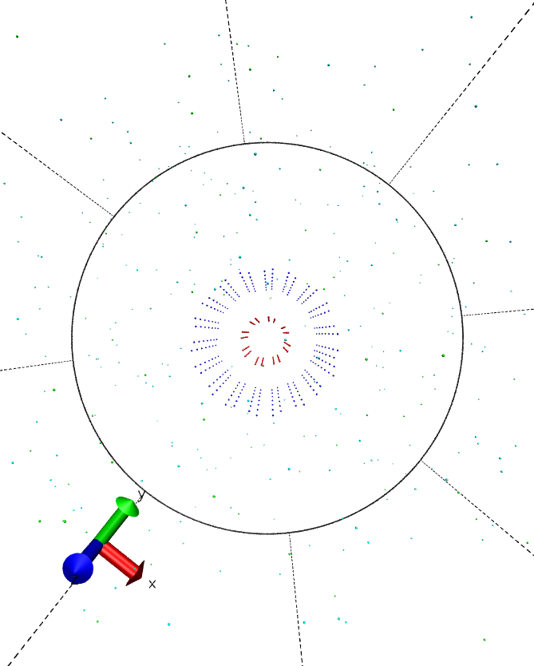
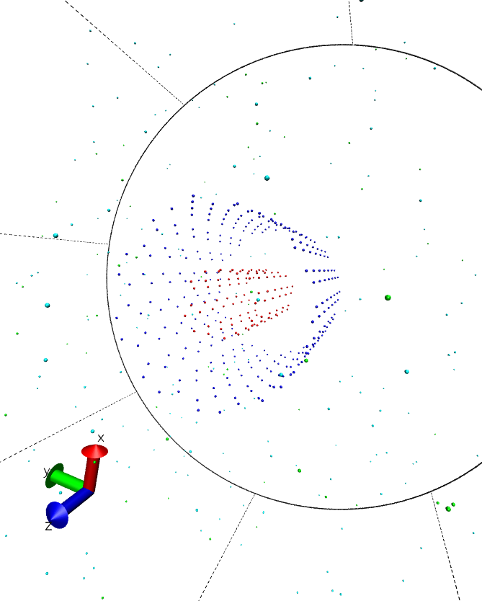
Modelling parameter for simulation
 | Number of atom |  | Nanotube structure |  |  | Remarks
 | # Al | # Si | Thickness Al-Si [Å] | Inner radius [Å] | Length [Å]
Parameter | nppt(Al) | nppt(Si) | dcap | rcap | lcap
Same # atom, different thickness | 100 | 400 | 100 | 60 | 700
 | 100 | 400 | 180 | 60 | 700 | Standard
 | 100 | 400 | 240 | 60 | 700
 | 100 | 400 | 500 | 60 | 700
Same charge, different thickness | 100 | 267 | 100 | 60 | 700
 | 100 | 500 | 240 | 60 | 700
 | 100 | 933 | 500 | 60 | 700
Comparing with Al+Si NT and Al/Si NT | 100 | - | - | 60 | 700
 | - | 400 | 180 | 60 | 700
Si(-) outside
dcap
rcap
Al(+) inside
60+100Å
60+180Å
60+500Å
60+240Å

Slide 14
Modelling parameter for simulation
 | Number of atom |  | Nanotube structure |  |  | Remarks
 | # Al | # Si | Thickness Al-Si [Å] | Inner radius [Å] | Length [Å]
Parameter | nppt(Al) | nppt(Si) | dcap | rcap | lcap
Same # atom, different thickness | 100 | 400 | 100 | 60 | 700
 | 100 | 400 | 180 | 60 | 700 | Standard
 | 100 | 400 | 240 | 60 | 700
 | 100 | 400 | 500 | 60 | 700
Same charge, different thickness | 100 | 267 | 100 | 60 | 700
 | 100 | 500 | 240 | 60 | 700
 | 100 | 933 | 500 | 60 | 700
Comparing with Al+Si NT and Al/Si NT | 100 | - | - | 60 | 700
 | - | 400 | 180 | 60 | 700
Al(+) inside
60Å
60Å
Si(-) outside
60+180Å
240Å

Slide 15
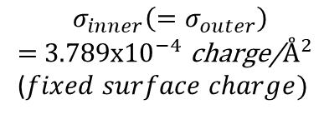
Modelling parameter for simulation
 | Number of atom |  | Nanotube structure |  |  | Remarks
 | # Al | # Si | Thickness Al-Si [Å] | Inner radius [Å] | Length [Å]
Parameter | nppt(Al) | nppt(Si) | dcap | rcap | lcap
Same # atom, different thickness | 100 | 400 | 100 | 60 | 700
 | 100 | 400 | 180 | 60 | 700 | Standard
 | 100 | 400 | 240 | 60 | 700
 | 100 | 400 | 500 | 60 | 700
Same charge, different thickness | 100 | 267 | 100 | 60 | 700
 | 100 | 500 | 240 | 60 | 700
 | 100 | 933 | 500 | 60 | 700
Comparing with Al+Si NT and Al/Si NT | 100 | - | - | 60 | 700
 | - | 400 | 180 | 60 | 700
dcap
rcap
$$σ_{inner}\left(=σ_{outer}\right)$$
$=$ 3.789x${10}^{−4}$ charge/$Å^{2}$
($fixed surface charge)$
60+100Å
60+180Å
60+500Å
60+240Å

Slide 16
Result titration curve with pH
# Al = 100 Rin(rcap) = 60 |  | Al |  |  |  |  |  |  | Si |  |  |  |  |  |  | Remarks
# Si | Thickness Al-Si [Å] | pH |  |  |  |  |  |  | pH
nppt(Si) | dcap | 2 | 3 | 4 | 5 | 6 | 7 | 8 | 2 | 3 | 4 | 5 | 6 | 7 | 8
400 | 100
400 | 180 | 1.000 | 1.000 | 1.000 | 0.989 | 0.997 | 0.966 | 0.729 | 0.000 | 0.010 | 0.107 | 0.428 | 0.818 | 0.987 | 0.996 | Standard
400 | 240 | 0.810 | 0.580 | 1.000 | 0.100 | 0.030 | 0.000 | 0.000 | 0.000 | 0.000 | 0.104 | 0.000 | 0.002 | 0.012 | 0.060
400 | 500
267 | 100
500 | 240
933 | 500
- | -
400 | 240

Slide 17
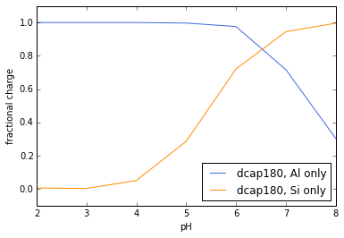
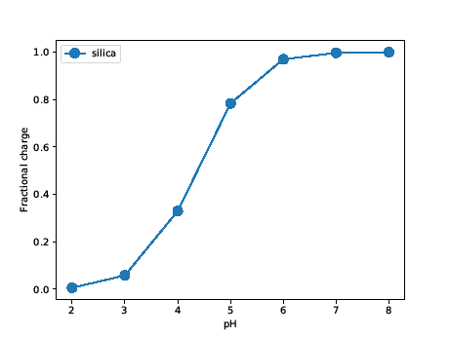
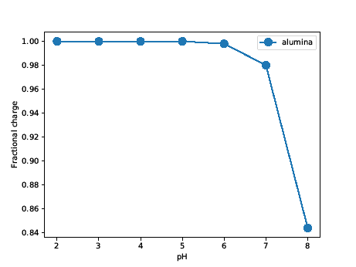
Result titration curve with increasing pH, Al only & Si Only separately
From Constanza
Low pH : HA +H₂O → A⁻ +H₃O⁺
High pH : B + H₂O → BH⁺ +OH⁻
For finding the most suitable dcap(thickness) without mutual interaction btw Al & Si

Slide 18
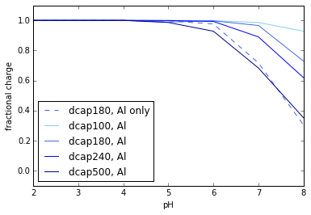
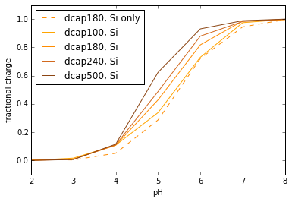
Result titration curve with increasing pH, same # of atoms
Al : titration curve with dcap500Å ≈ the most suitable
Si : titration curve with dcap100Å ≈ the most suitable

Slide 19
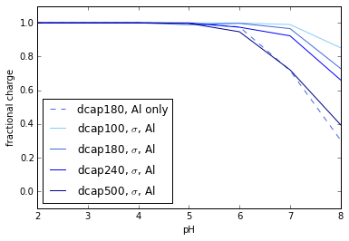
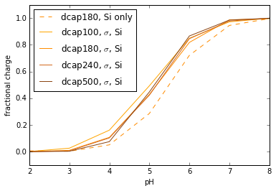

Result titration curve with increasing pH, same surface charge($σ_{in}=σ_{out}$)
Both Al, Si : system with dcap500Å ≈ the most suitable system
→

Slide 20
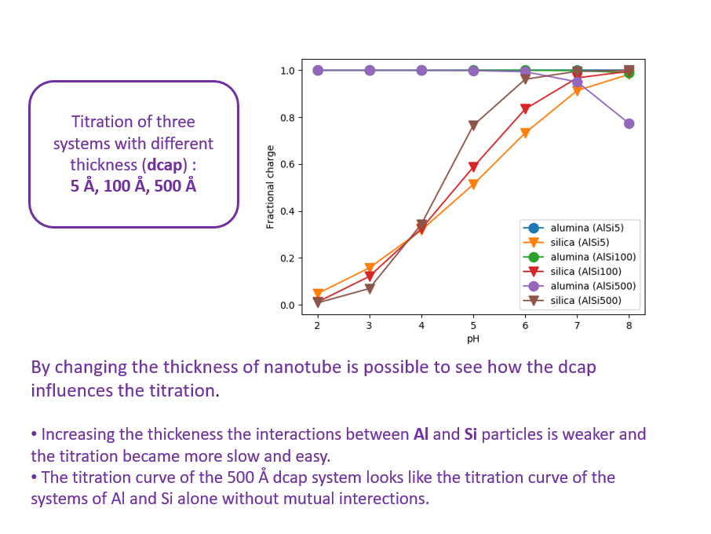
Conclusion and future work
From Costanza
Minimize charge effect of Al-Si itself within nanotube
→ large dcap (thickness)
Why are two cases above different?
Implement nanotube with charged polymers

Slide 21
Halloysite Nanotube quenched polymer with charge

Slide 22
Modelling with quenched polymer, parameter after equilibrium
 | Number of atom |  | Nanotube structure |  |  | Radius of atom |  | Cylinder system structure |  | Dissociation constant |  | Remarks
 | # Al | # Si | Thickness Al-Si [Å] | Inner radius [Å] | Length [Å] | Rad Al [Å] | Rad Si [Å] | Cylinder rad [Å] | Cylinder length [Å] | pK(Al) | pK(Si)
Parameter | nppt(Al) | nppt(Si) | dcap | rcap | lcap | radat(Al) | radat(Si) | cylrad | cyllen | pK(1) | pK(3)
 | 100 | 400 | 100 | 60 | 700 | 2.0 | 2.0 | 1000 | 1500 | 9 | 4.2

Slide 23
Reference titration curve with increasing pH, same # of atoms
1. Images
1-1. https://www.eng.ed.ac.uk/about/news/20160105/flagship-research-programme-awarded-epsrc-grant, sep 2018
1-2. https://www.sciencedirect.com/science/article/pii/S1387181115004904, sep 2018
1-3. Development of a coarse-grained model for calcium minerals, Computational and Theoretical Chemistry – Biomineralization, ‘https://www.chemie.uni-konstanz.de/ag-peter/research/research-projects/material-science-related-topics/biomineralization/’
2. Papers
2-1. Properties and applications of halloysite nanotubes: recent research advances and future prospects, Peng Yuan a,d,⁎, Daoyong Tan b, Faïza Annabi-Bergaya, Applied Clay Science, 2015
2-2. Thermodynamics of Proton Binding of Halloysite Nanotubes, Clemente Bretti,† Salvatore Cataldo,‡ Antonio Gianguzza,‡ Gabriele Lando,† Giuseppe Lazzara,‡Alberto Pettignano,*,‡ and Silvio Sammartano†, J of Physical Chem. 2016
2-3. An assembly of organic-inorganic composites using halloysite clay nanotubes, Giuseppe Lazzara a,⁎⁎, Giuseppe Cavallaro a, Abhishek Panchal b, Rawil Fakhrullinc, Anna Stavitskaya d, Vladimir Vinokurov d,⁎⁎, Yuri Lvovb,d,⁎, Current Opinion in Colloide interface science, 2017
3. Books
3-1. Soil and Water Chemistry: An Integrative Approach, Second Edition, Av Michael E. Essington, p86
4. Work from Constanza Tedesco
4-1. Powerpoint Presentation ‘Halloysite Presentation’, 2018

